Slide 1
Smart FAI checklist

Slide 2
FAI Function
Function | Owner | Employee | Description
Paperless system (Web + App Android) | FII | Mai Ngọc Tuyên-26143
Device use application |  |  | Ongoing
Setup QRCode + Parameter for Machine (Paperless) | ME | Thân Thị Hà-30704 | Config on Paperless System - Setup QRCode (Done) - Setup Parameter (Open)
MO information + ECN no + Part number information Database: Account get data(SMT_FAI, WO_REQUEST) Webservice: + Get machine + Get solder + Get ECN no | IT | Đỗ Đức Xuân-30595 | Webservice (done) Account Database (done)
Machine collection data | ME | Thân Thị Hà-30704 | Server connect SMT machine
 | IT | Đỗ Đức Xuân-30595 | Support network
Use system (Checking and signing) List user (SOP/form_user.xlsx) Link download SOP: http://10.224.81.94/paperless/ws-data/release/SOP.zip | ME | Thân Thị Hà-30704 | Data user (Done)
 | PD | Nông Thị Bình-30718 Nguyễn Thị Nền-30717 | Data user (Done)
 | QA | Phan Thị Việt-26618 Nguyễn Dương Tuấn Anh-26618 | Data user (Done)

Slide 3
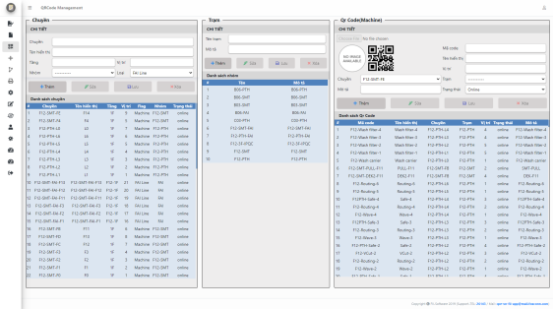
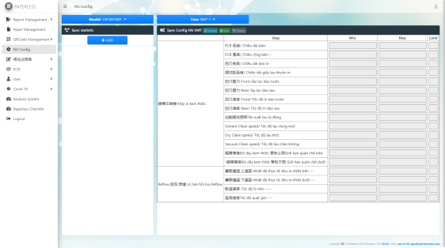
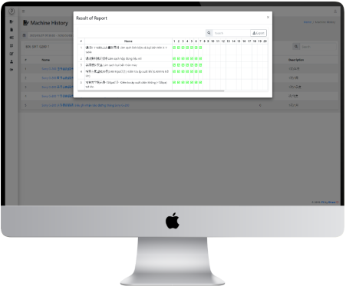
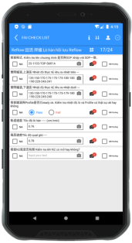
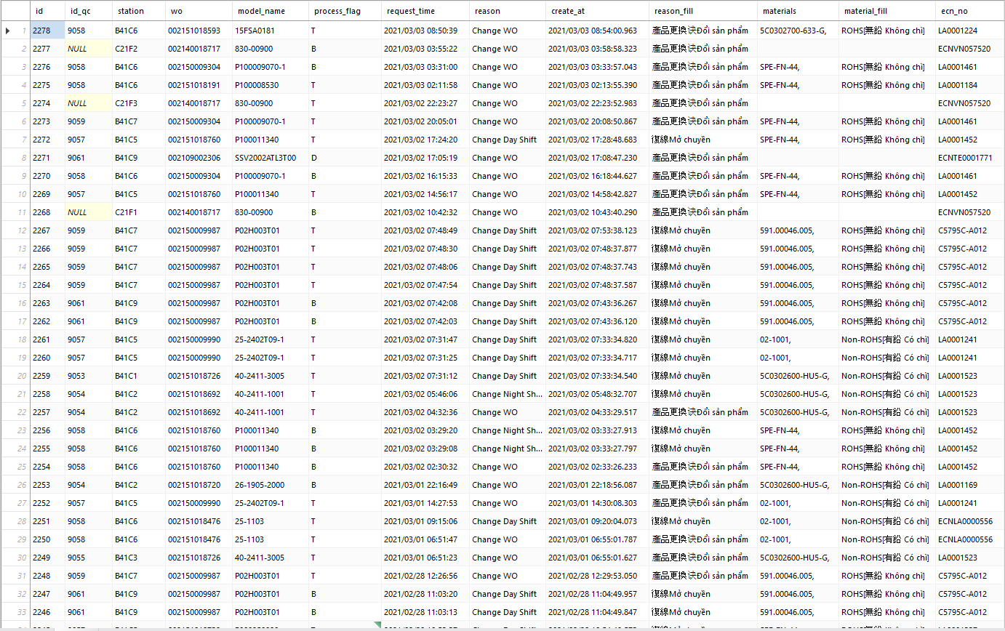
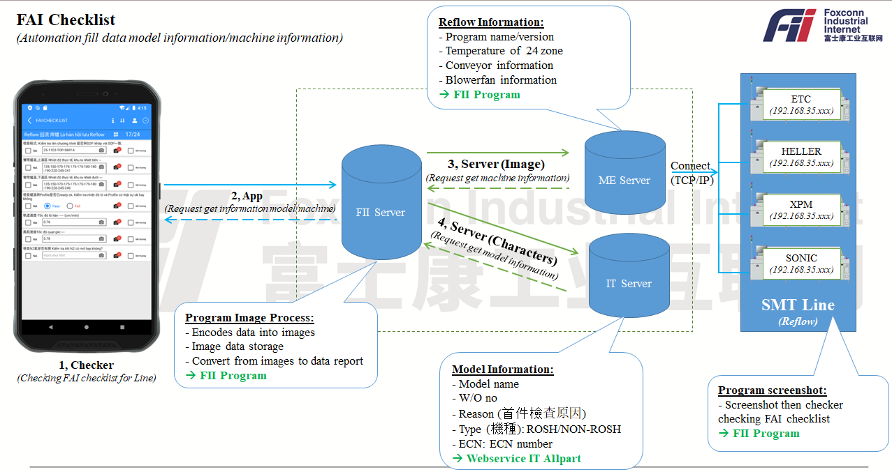
FAI Function
Setup QRCode + Parameter
Device use application
Use system
- User information
- Permission
Internal Network
MO information + ECN no + Part number information
Machine collection data

Slide 4
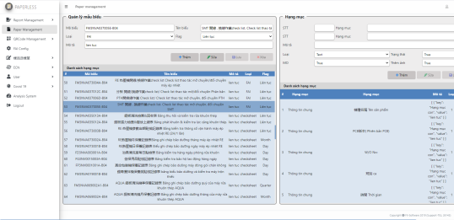
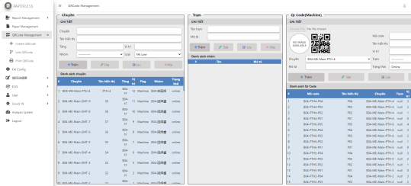
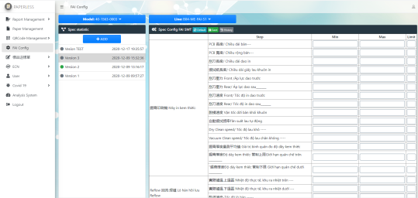
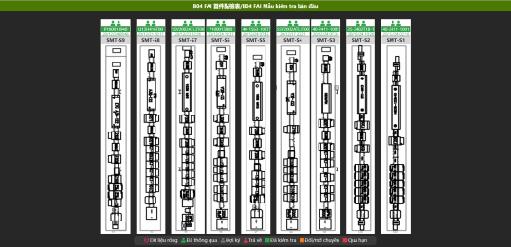
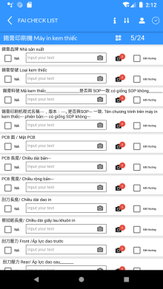
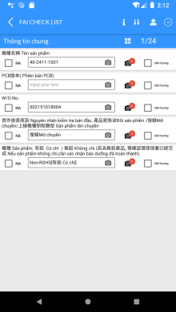
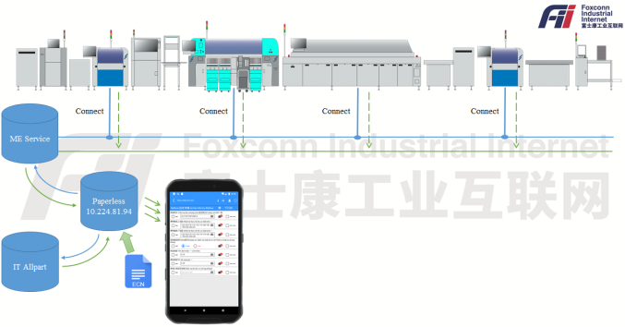
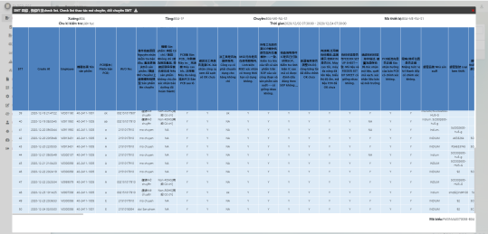
FAI Checklist System
Done
Done
Done
Done
1, FAI Form Management
(Create and update form content)
https://10.224.81.94:6443/paperless/report-form
2, QR code Management
(Create and update QRCode)
/paperless/qrcode-management
3, Spec & Checklist content validation
(Setup validation for form content by model and line)
https://10.224.81.94:6443/paperless/fai-config
4, FAI checklist dashboard
(Check status and information for line)
https://10.224.81.94:6443/paperless /b04-fai-2
12/29
Done
01/08
01/15
Done
Done
5, Mobile APP Checklist creation and submit UI&UX
(Update notify for step when content not in spec by step)
6, Machine Parameter data collection
(Connect to Reflow, Printer,… and read program information of machine)
7, Checklist report management
(History checking and analysis data)
http://10.224.81.94:8888/paperless/machine-history

Slide 5
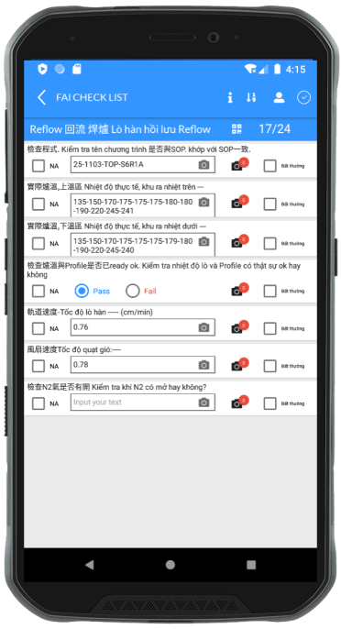
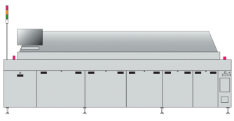
FAI Checklist
(Automation fill data model information/machine information)
Reflow Information:
- Program name/version
- Temperature of 24 zone
- Conveyor information
- Blowerfan information
→ FII Program
SMT Line
(Reflow)
ETC
(192.168.35.xxx)
ME Server
FII Server
HELLER
(192.168.35.xxx)
3, Server (Image)
(Request get machine information)
Connect
(TCP/IP)
2, App
(Request get information model/machine)
XPM
(192.168.35.xxx)
4, Server (Characters)
(Request get model information)
IT Server
SONIC
(192.168.35.xxx)
Program Image Process:
- Encodes data into images
- Image data storage
- Convert from images to data report
→ FII Program
1, Checker
(Checking FAI checklist for Line)
Model Information:
- Model name
- W/O no
- Reason (首件檢查原因)
- Type (機種): ROSH/NON-ROSH
- ECN: ECN number
→ Webservice IT Allpart
Program screenshot:
- Screenshot then checker checking FAI checklist
→ FII Program

Slide 6
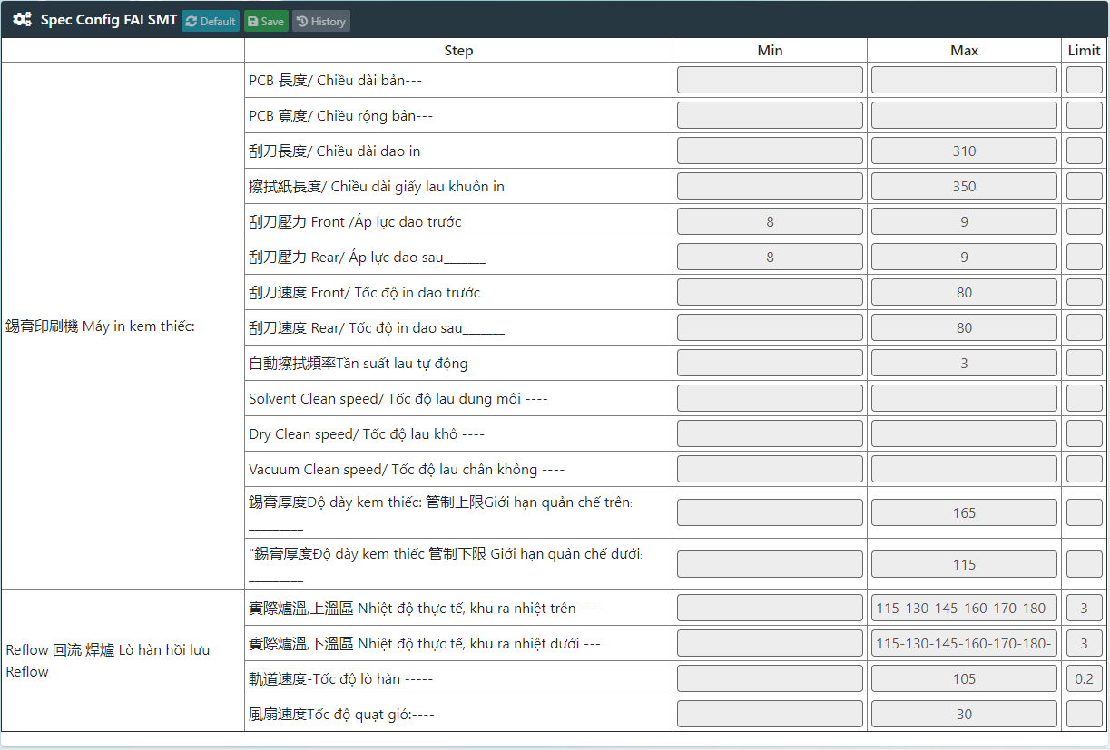
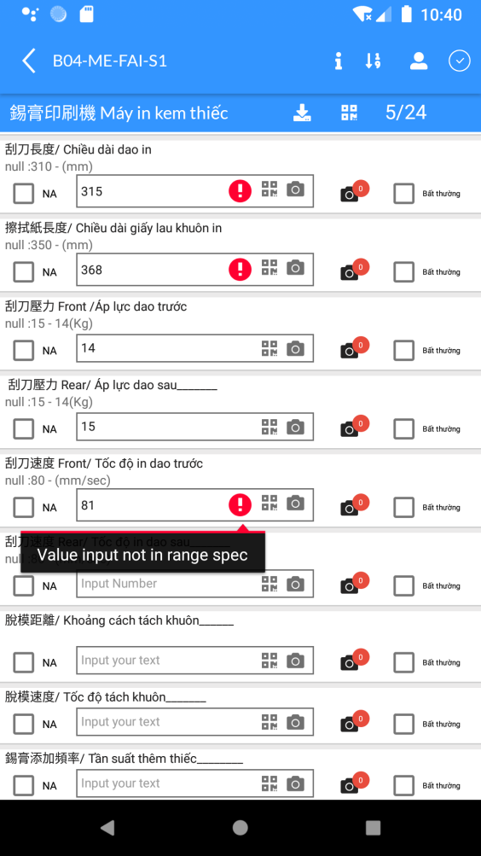
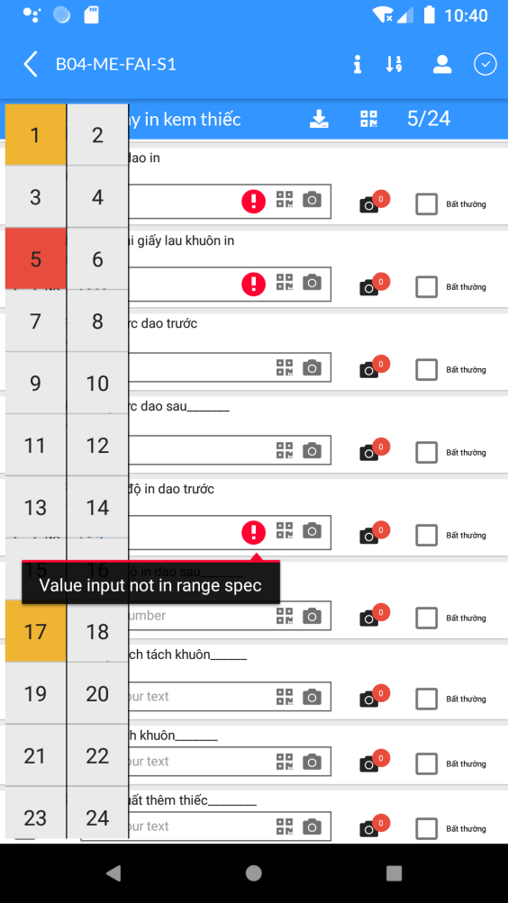
FAI Checklist
(Validation content in FAI checklist)
Admin System
They will setup parameter for content on FAI checklist by Model and Line
Checker
After Admin setup parameter for model, App will base on parameter so checking with value fill of checker, if content have issue then app will hightlight item for checker and they need re-check it.
15 – 14 (Kg)
UTL: 15 LTL: 14 Unit: Kg
App hightlight item have issue

Slide 7
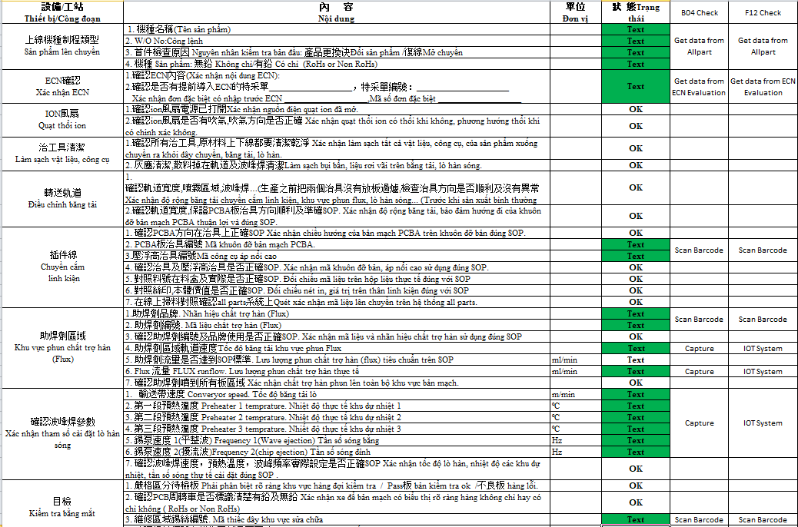
Form FAI PTH
(Update content form)
Issue | Status
Test new form FAI PTH checklist on B04 – PTH 2 | Ongoing
Verify new format form PTH FAI checklist for F12 | Ongoing

Slide 8
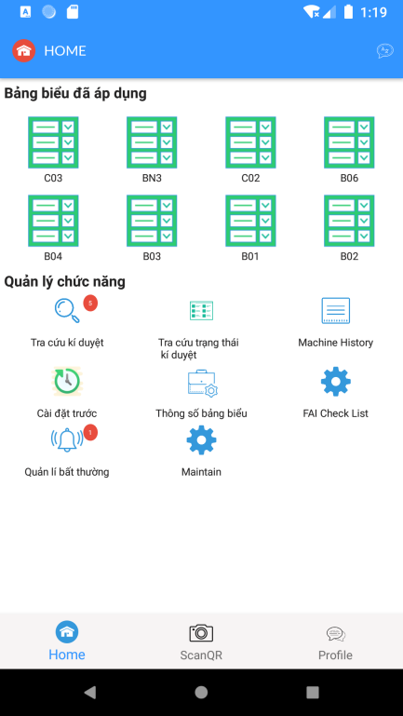
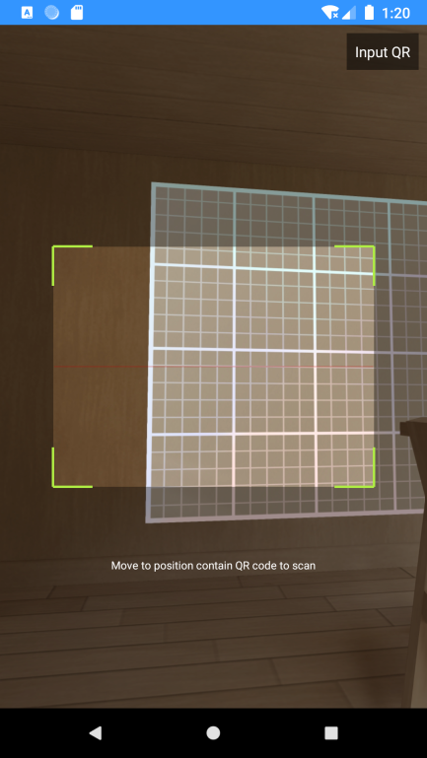
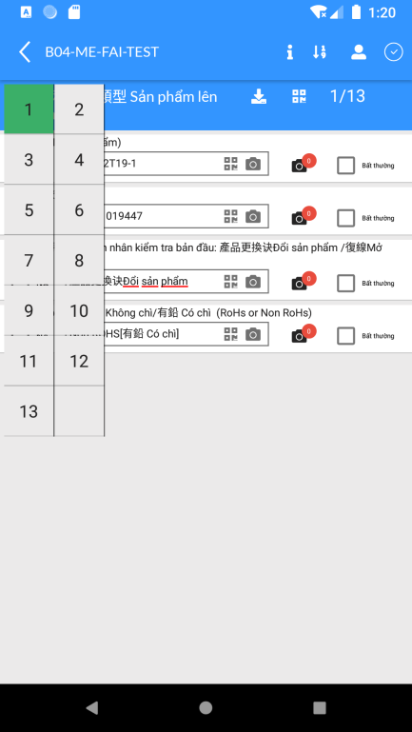
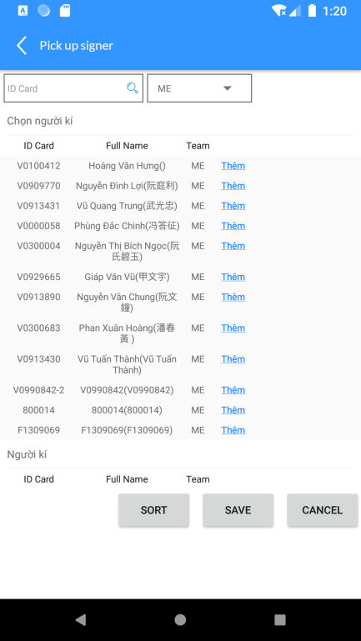
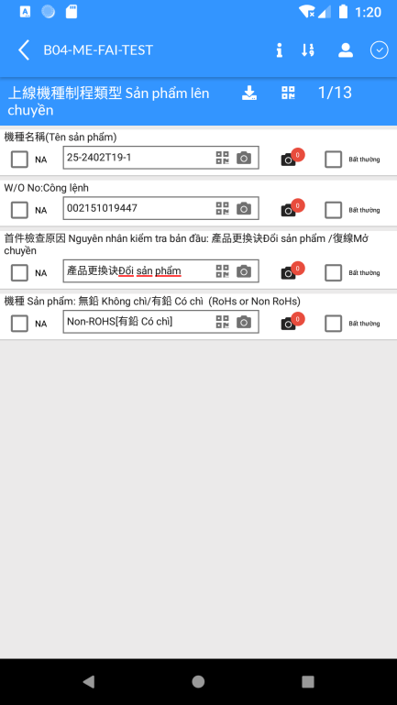
Checker (Line Leader)
Click “FAI Checklist”
Scan QRCode FAI
Fill Content
Choose Signer
(ME/QA)
Submit Form

Slide 9
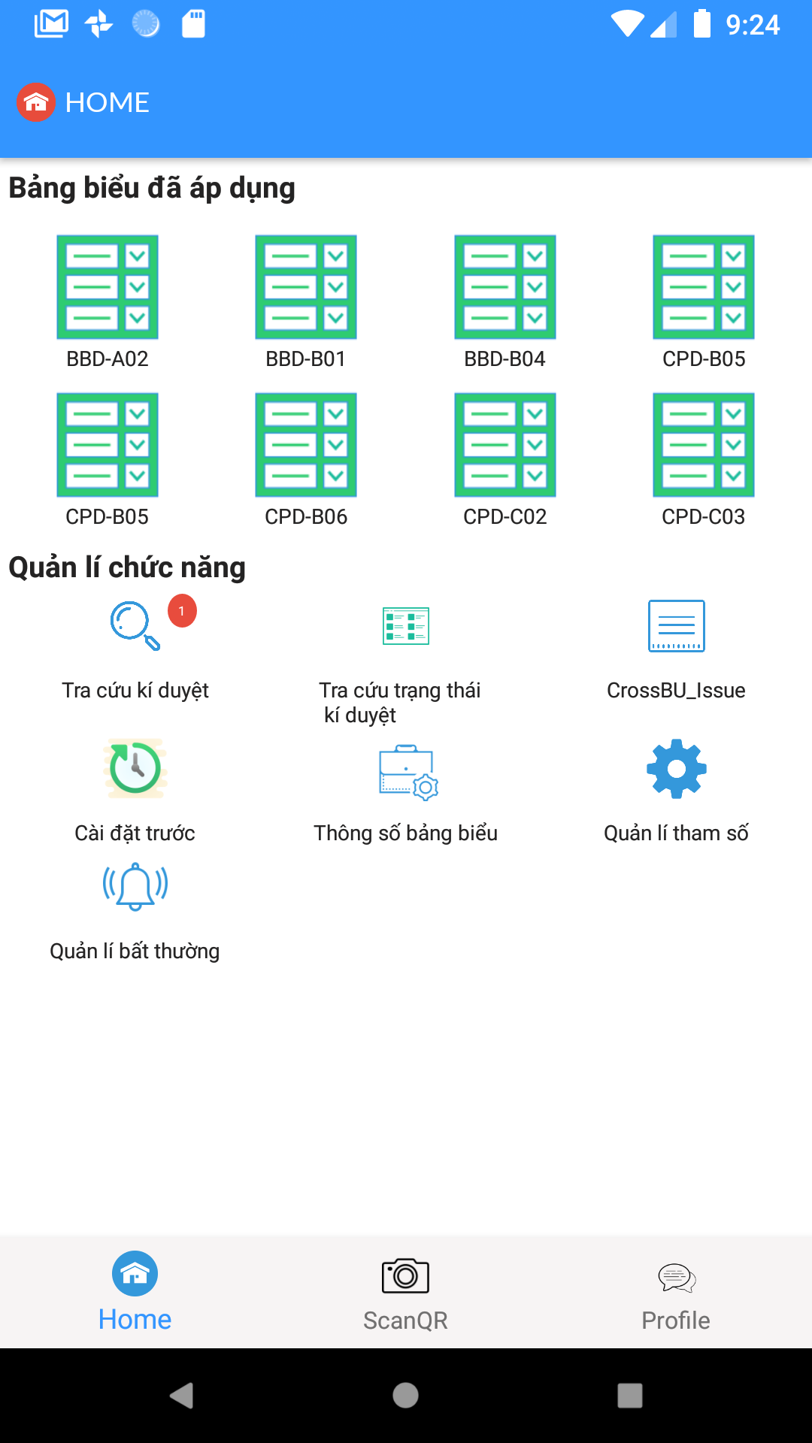
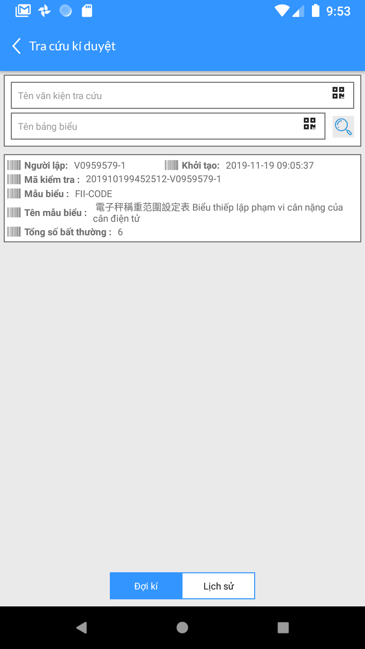
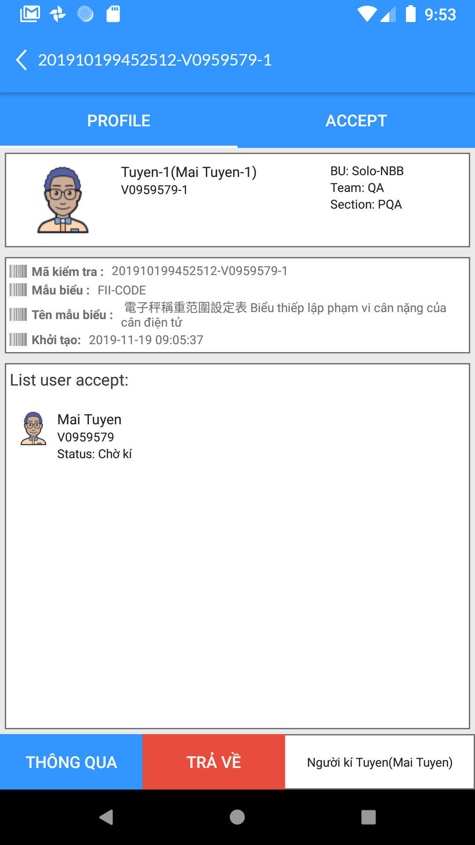
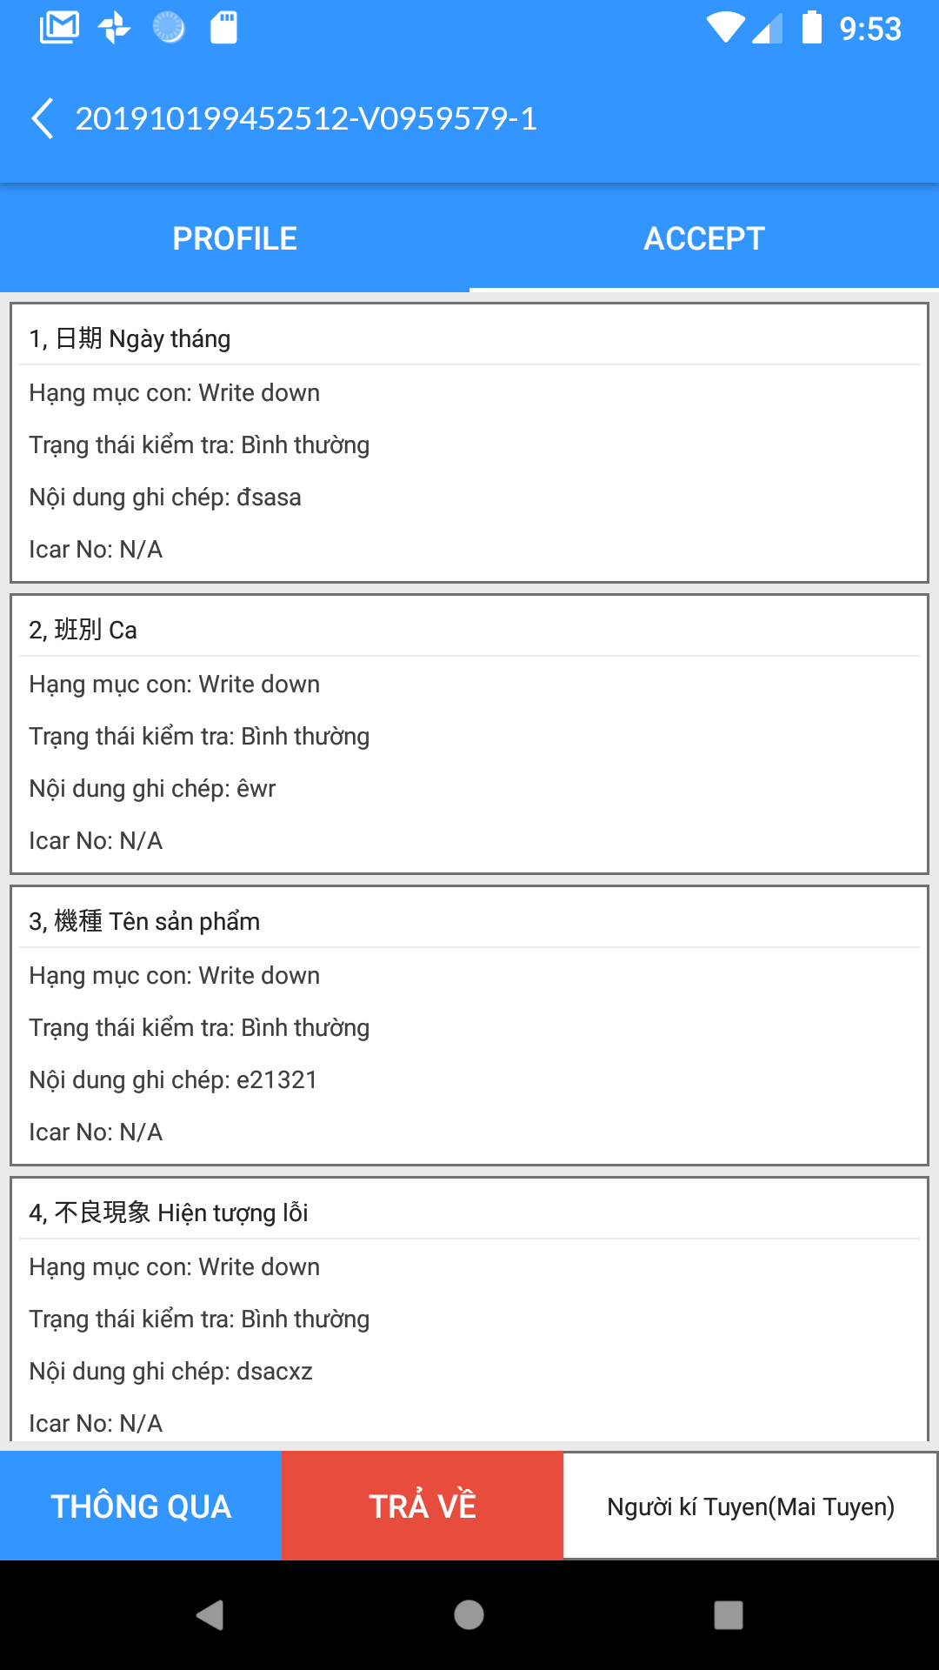
Signer (ME/QA)

